Slide 1
Object Oriented Programming Lecture-17
Base vs derived class reference
Prof. Varsha Dange

Slide 2
Base Class vs Derived class Reference Variable
A base class reference variable may be assigned the address of either a base class object or a derived class object.
A derived class reference variable can only assigned the address derived class object.
Base class also known as parent class or super class is a class which is extended by another. Eg. Animal Class
While a child class extends from its super class. Eg. Lion Class
We know that all lions are animals. But not all animals are essentially lions.
The subclass is just a subset of the superclass.

Slide 3
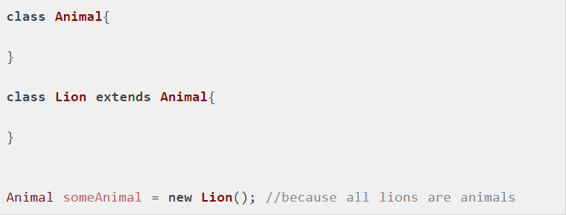
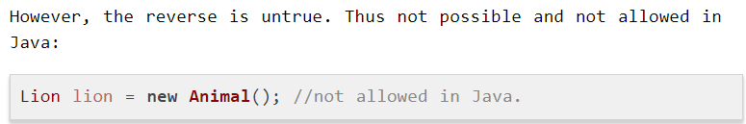
Base Class vs Derived class Reference Variable
Hence, when we have a base class reference, we are allowed to assign derived class object into it.

Slide 4
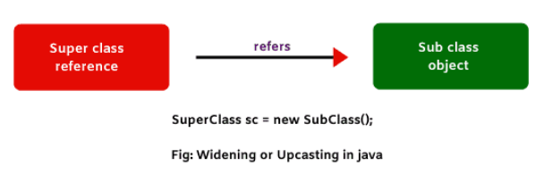
Upcasting and down casting in java
When the reference variable of super class refers to the object of subclass, it is known as widening or upcasting in java.
In other words, subclass object type is casting into superclass type, it is called widening or upcasting.

Slide 5


Upcasting in java
1. Super class reference is used to refer to superclass object.
2. Similarly, sub class reference is used to point to sub class object.
In the above two statements, we do not need casting.
This is because on the left side and at the right side of assignment operator (=), we have the same data type.
class One’s reference o is pointing or referring to One’s object.
class Two’s reference t is pointing to Two’s object.

Slide 6
Upcasting in java
For example: in this case, we will need casting.
We will convert object’s data type into class O using cast operator. It can be done like this:
Here, sub class object type has been converted into super class type. This kind of conversion is called upcasting or widening in java.
But it happens automatically. We don’t have to do explicitly .
Example
upcasting can only be possible to method in child which are already there in parent.

Slide 7
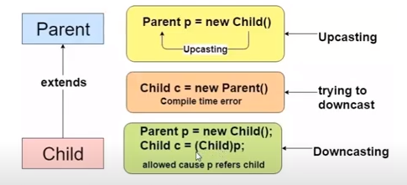
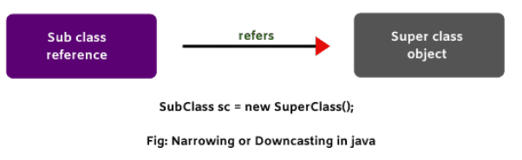
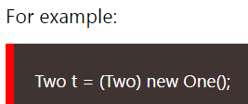
Downcasting (Narrowing) in Java
When subclass reference refers to super class object, it is called narrowing or downcasting in java.
Subclass type refer to object of super class . Example
Here, we are converting superclass object type into subclass type. Therefore, we need a compulsory cast operator. If we perform it directly, Java compiler will give compile-time error.

Slide 8
Downcasting (Narrowing) in Java
To overcome this problem, we will have to modify the previous code.
Example

